Slide 1
Software Engineering (Introduction)
Fall 2015

Slide 2
Text
Object-Oriented and Classical Software Engineering
Eighth Edition, WCB/McGraw-Hill, 2011 Stephen R. Schach
Reading assignment
Chapter 1

Slide 3
What do you want to get out of this class?

Slide 4
CHAPTER 1
THE SCOPE OF
SOFTWARE
ENGINEERING

Slide 5
What is software?
Software is:
(1) instructions (computer programs) that when executed provide desired features, function, and performance;
(2) data structures that enable the programs to adequately manipulate information
(3) documentation that describes the operation and use of the programs.

Slide 6
Why is software different?
Software is developed or engineered, it is not manufactured in the classical sense.
Software doesn't "wear out."
Although the industry is moving toward component-based construction, most software continues to be custom-built.

Slide 7
Wear vs. Deterioration

Slide 8
Software Engineering Defined
IEEE
Software Engineering:
The application of a systematic, disciplined, quantifiable approach to the development, operation, and maintenance of software; that is, the application of engineering to software.
The study of approaches as in (1).

Slide 9
Historical Aspects
1968 NATO Conference, Garmisch, Germany
Aim: To solve the software crisis
Software is delivered
Late
Over budget
With residual faults

Slide 10
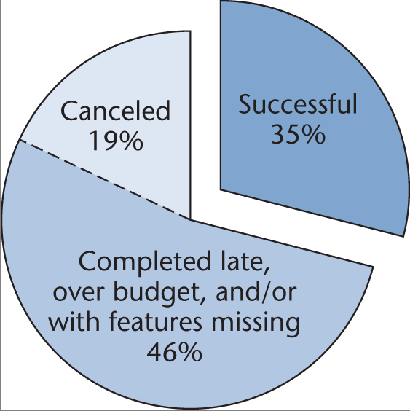
Standish Group Data
Data on projects completed in 2006
Figure 1.1
Just over one in three projects was successful

Slide 11
Cutter Consortium Data
2002 survey of information technology organizations
78% have been involved in disputes ending in litigation
For the organizations that entered into litigation:
In 67% of the disputes, the functionality of the information system as delivered did not meet up to the claims of the developers
In 56% of the disputes, the promised delivery date slipped several times
In 45% of the disputes, the defects were so severe that the information system was unusable

Slide 12
Conclusion
The software crisis has not been solved
Perhaps it should be called the software depression
Long duration
Poor prognosis

Slide 13
Economic Aspects
Suppose coding method CM_{new} is 10% faster than currently used method CM_{old}. Should it be used?
Common sense answer
Of course!
Software Engineering answer
Consider the cost of training
Consider the impact of introducing a new technology
Consider the effect of CM_{new} on maintenance

Slide 14
Life Cycle Models
Life-cycle model
The steps (phases) to follow when building software
A theoretical description of what should be done
Important models
Waterfall
Iterative
Incremental
Agile

Slide 15

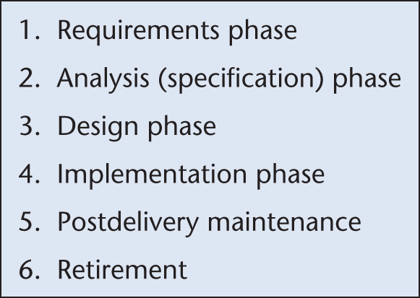
Waterfall Life-Cycle Model
Classical model (1970)

Slide 16
Problems
Most of the real projects rarely follow the sequential flow that the model proposes.
Difficult for the customer to state all requirements explicitly before the next step.
A working version will not be available until late in the project time-span.
Some project team members must wait for other members of the team to complete dependent tasks.

Slide 17
Modern Maintenance Definition
In 1995, the International Standards Organization and International Electrotechnical Commission defined maintenance operationally
Maintenance is nowadays defined as
The process that occurs when a software artifact is modified because of a problem or because of a need for improvement or adaptation

Slide 18
The Importance of Post-delivery Maintenance
Development (building software from scratch) is rare today
Reuse is widespread
Bad software is discarded
Good software is maintained, for 10, 20 years, or more
Software is a model of reality, which is constantly changing

Slide 19
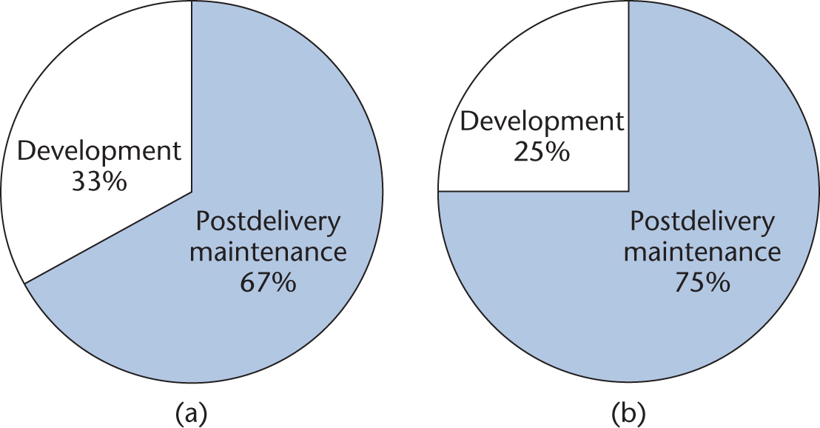
Time (= Cost) of Post-delivery Maintenance
(a) Between 1976 and 1981
(b) Between 1992 and 1998
Figure 1.3

Slide 20
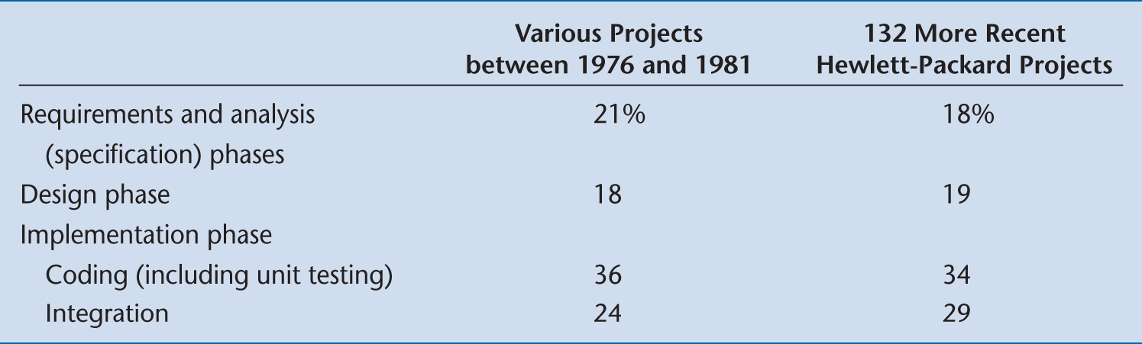
The Costs of the Classical Phases
Surprisingly, the costs of the classical phases have hardly changed
Figure 1.4

Slide 21
Consequence of Relative Costs of Phases
Return to CM_{old} and CM_{new}
Reducing the coding cost by 10% yields at most a 0.85% reduction in total costs
Consider the expenses and disruption incurred
Reducing postdelivery maintenance cost by 10% yields a 7.5% reduction in overall costs

Slide 22
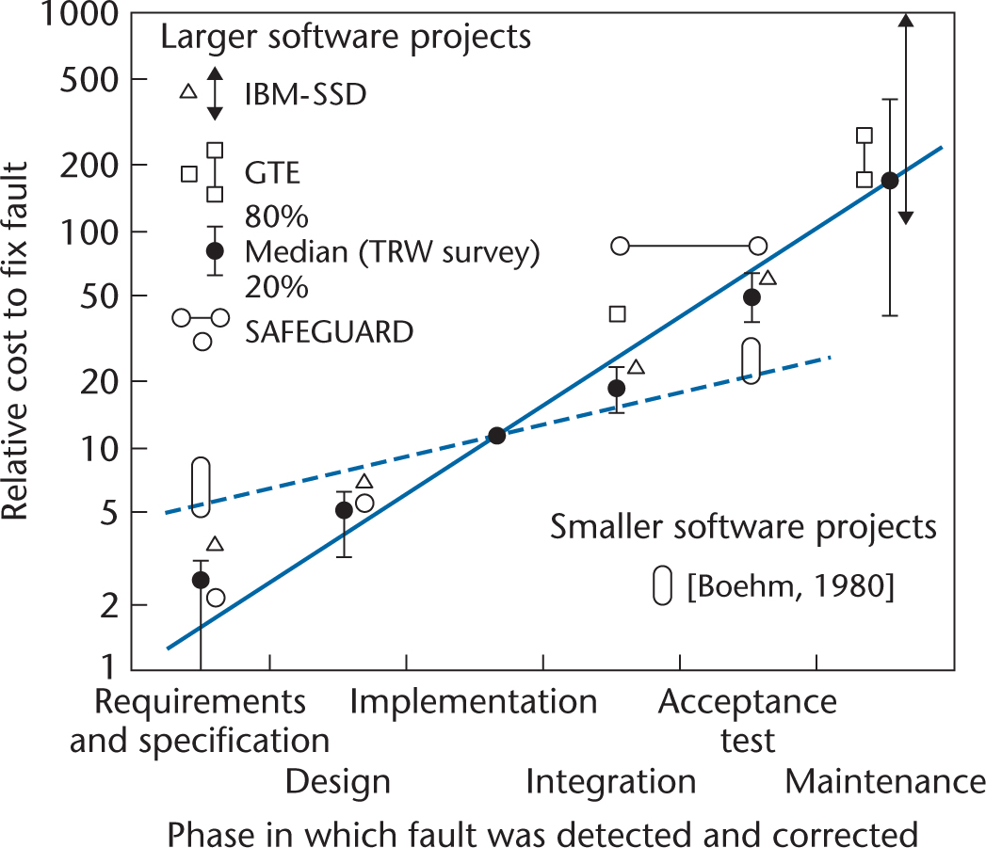
Requirements, Analysis, and Design Aspects
The earlier we detect and correct a fault, the less it costs

Slide 23
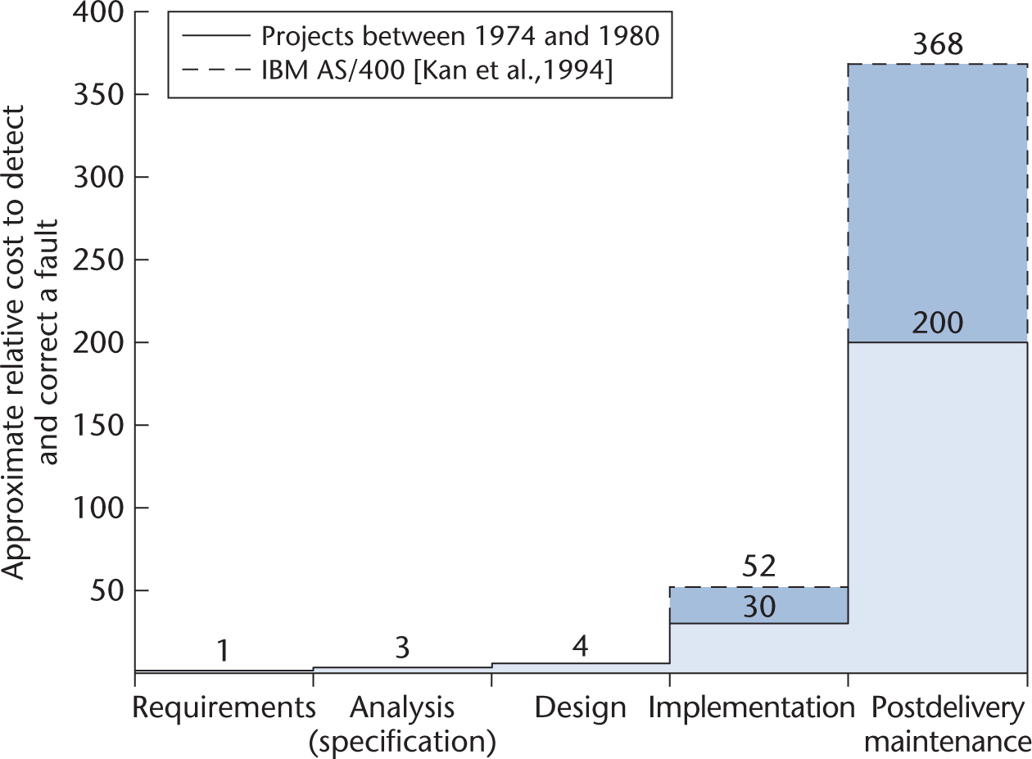
Requirements, Analysis, and Design Aspects (cont)
The previous figure redrawn on a linear scale
Figure 1.6

Slide 24
Requirements, Analysis, and Design Aspects (cont)
To correct a fault early in the life cycle
Usually just a document needs to be changed
To correct a fault late in the life cycle
Change the code and the documentation
Test the change itself
Perform regression testing
Reinstall the product on the client’s computer(s)

Slide 25
Requirements, Analysis, and Design Aspects (cont)
Between 60 and 70% of all faults in large-scale products are requirements, analysis, and design faults
Example: Jet Propulsion Laboratory inspections
1.9 faults per page of specifications
0.9 per page of design
0.3 per page of code

Slide 26
Conclusion
It is vital to improve our requirements, analysis, and design techniques
To find faults as early as possible
To reduce the overall number of faults (and, hence, the overall cost)

Slide 27
Team Programming Aspects
Hardware is cheap
We can build products that are too large to be written by one person in the available time
Software is built by teams
Interfacing problems between modules
Communication problems among team members

Slide 28
Why There Is No Planning Phase
We cannot plan at the beginning of the project —we do not yet know exactly what is to be built

Slide 29
Planning Activities of the Classical Paradigm
Preliminary planning of the requirements and analysis phases at the start of the project
The software project management plan is drawn up when the specifications have been signed off by the client
Management needs to monitor the SPMP throughout the rest of the project

Slide 30
Conclusion
Planning activities are carried out throughout the life cycle
On-going process
There is no separate planning phase

Slide 31
Why There Is No Testing Phase
It is far too late to test after development and before delivery

Slide 32
Testing Activities of the Classical Paradigm
Verification
Testing at the end of each phase (too late)
Validation
Testing at the end of the project (far too late)

Slide 33
Conclusion
Continual testing activities must be carried out throughout the life cycle
This testing is the responsibility of
Every software professional, and
The software quality assurance group
There is no separate testing phase

Slide 34
Why There Is No Documentation Phase
It is far too late to document after development and before delivery

Slide 35
Documentation Must Always be Current
Key individuals may leave before the documentation is complete
We cannot perform a phase without having the documentation of the previous phase
We cannot test without documentation
We cannot maintain without documentation

Slide 36
Conclusion
Documentation activities must be performed in parallel with all other development and maintenance activities
There is no separate documentation phase

Slide 37
The Object-Oriented Paradigm
The structured paradigm was successful initially
It started to fail with larger products (> 50,000 LOC)
Post-delivery maintenance problems (today, 70 to 80% of total effort)
Reason: Structured methods are
Action oriented (e.g., finite state machines, data flow diagrams); or
Data oriented (e.g., entity-relationship diagrams, Jackson’s method);
But not both

Slide 38
The Object-Oriented Paradigm (cont)
Both data and actions are of equal importance
Object:
A software component that incorporates both data and the actions that are performed on that data

Slide 39
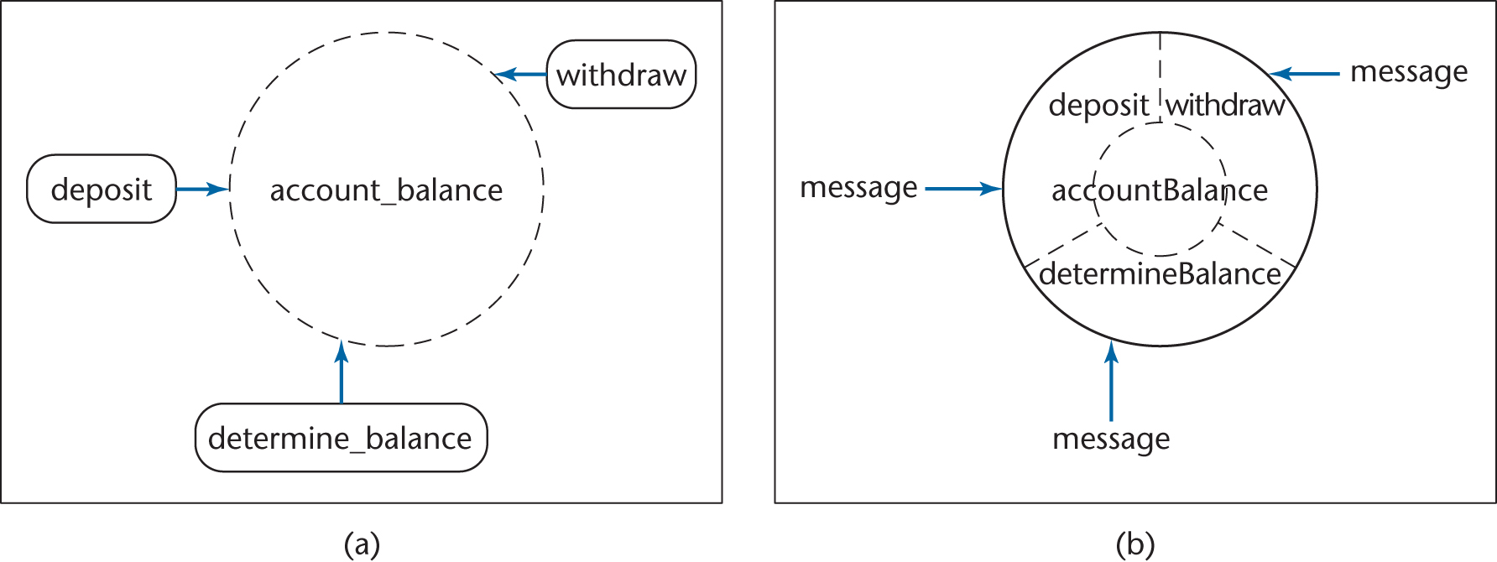
Structured versus Object-Oriented Paradigm
Information hiding
Responsibility-driven design
Impact on maintenance, development
Figure 1.7

Slide 40
Strengths of the Object-Oriented Paradigm
With information hiding, postdelivery maintenance is safer
The chances of a regression fault are reduced
Development is easier
Objects generally have physical counterparts
This simplifies modeling (a key aspect of the object-oriented paradigm)

Slide 41
Strengths of the Object-Oriented Paradigm (cont)
Well-designed objects are independent units
Everything that relates to the real-world item being modeled is in the corresponding object — encapsulation
Communication is by sending messages
This independence is enhanced by responsibility-driven design
A classical product conceptually consists of a single unit (although it is implemented as a set of modules)
The object-oriented paradigm reduces complexity because the product generally consists of independent units
The object-oriented paradigm promotes reuse
Objects are independent entities

Slide 42
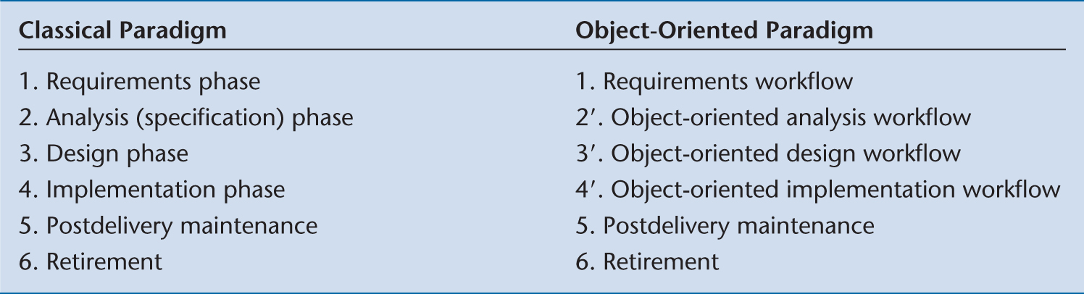
Classical Phases vs Object-Oriented Workflows
There is no correspondence between phases and workflows

Slide 43
Analysis/Design “Hump”
Structured paradigm:
There is a jolt between analysis (what) and design (how)
Object-oriented paradigm:
Objects enter from the very beginning
In the classical paradigm
Classical analysis
Determine what has to be done
Design
Determine how to do it
Architectural design — determine the modules
Detailed design — design each module

Slide 44
Removing the “Hump”
In the object-oriented paradigm
Object-oriented analysis
Determine what has to be done
Determine the objects
Object-oriented design
Determine how to do it
Design the objects
The difference between the two paradigms is shown on the next slide

Slide 45
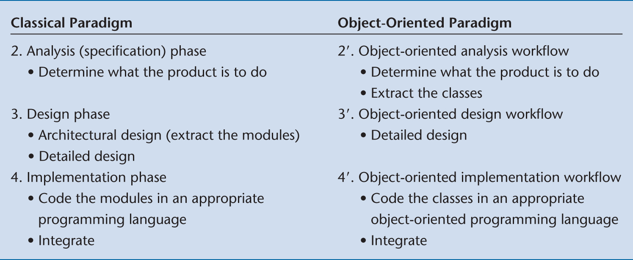
In More Detail
Objects enter here

Slide 46
Object-Oriented Paradigm
Modules (objects) are introduced as early as the object-oriented analysis workflow
This ensures a smooth transition from the analysis workflow to the design workflow
The objects are then coded during the implementation workflow
Ideally, the transition is smooth

Slide 47
The Object-Oriented Paradigm in Perspective
The object-oriented paradigm has to be used correctly
All paradigms are easy to misuse
When used correctly, the object-oriented paradigm can solve some (but not all) of the problems of the classical paradigm
The object-oriented paradigm has problems of its own
The object-oriented paradigm is the best alternative available today
However, it is certain to be (hopefully) superseded by something better in the future

Slide 48
Ethical Issues
Developers and maintainers need to be
Hard working
Intelligent
Sensible
Up to date and, above all,
Ethical
IEEE-CS ACM Software Engineering Code of Ethics and Professional Practice www.acm.org/serving/se/code.htm

